Slide 1
Capstone Project - Coursera
Location Recommendation for Indian Restaurant in New York

Slide 2
Content
Introduction / Business Problem
Solution / Methodology
Result / Discussion
Conclusion
Acknowledgement

Slide 3
1. Introduction / Business Problem
Lets say If you are a Business Manager who want to invest for ‘Indian Restaurant’ in your resident city. You are live in a city
which has fast growth.
Now the question is “ Where or Which Neighborhood to open restaurant ? ”
In order to get answer of this question, you have to build MODEL to get some recommendations where to open the Restaurant.
Therefore, firstly we will learn model of a Mature / Metropolitan city since we believe that it is more developed.
Your city become more bigger some day.
Another thing you believe is that any business venue does not exist alone and Indian restaurants always tends to be find some other type of shops because neighborhood have ‘Cultures’ to like them both.

Slide 4
2. Solution / Methodology
FLOWCHART
Learn how does other venues around the Indian Restaurant in a big city such as Toronto
Build a model that can predict number of the Indian Restaurant given the environmental venue information
Prediction of Indian Restaurant in Target City
Compare with current existing numbers and Recommend best Location

Slide 5
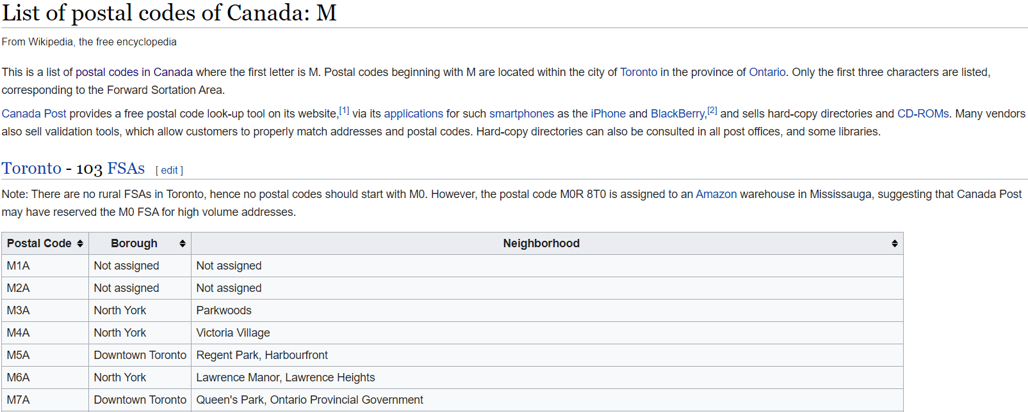
Data Import (Toronto)
Neighborhood Information from Wikipedia

Slide 6
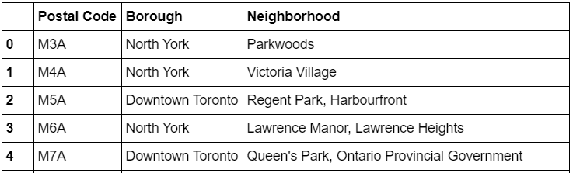
2. Scrap from website (https://en.wikipedia.org/wiki/List_of_postal_codes_of_Canada:_M) and organize into dataframe

Slide 7
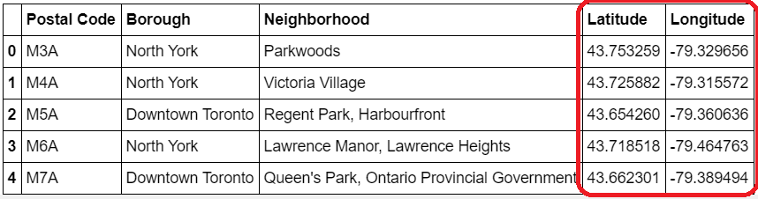
3. Location Information
Use geocoder package to get location information:

Slide 8
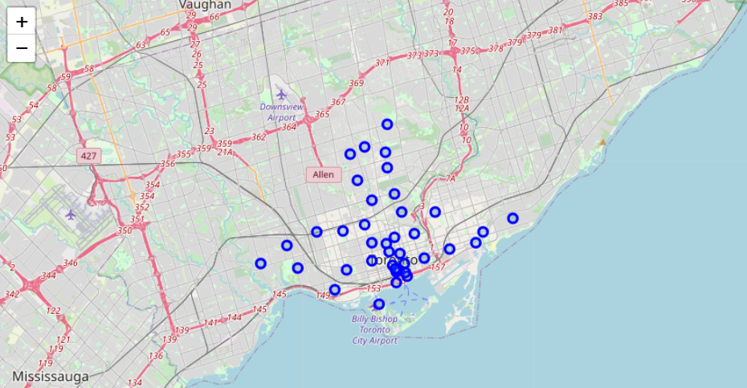
Plot the location using folium package
Neighborhood location in Toronto on Map

Slide 9
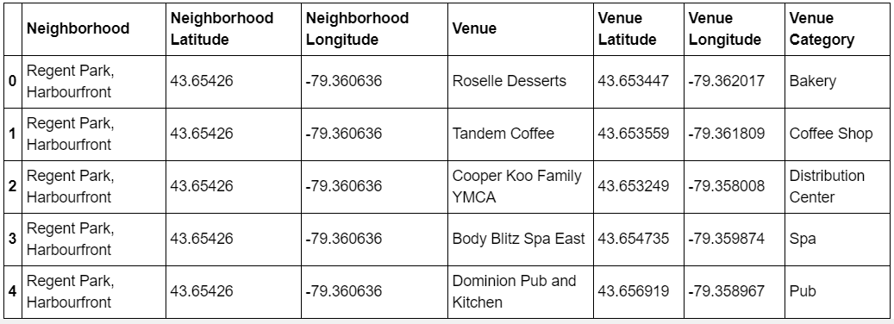
4. Get Venues Information
Use FOURSQUARE API , we can explore the venues around on specific location,
so we could achieve venues, name and category. (https://www.foursquare.com)

Slide 10
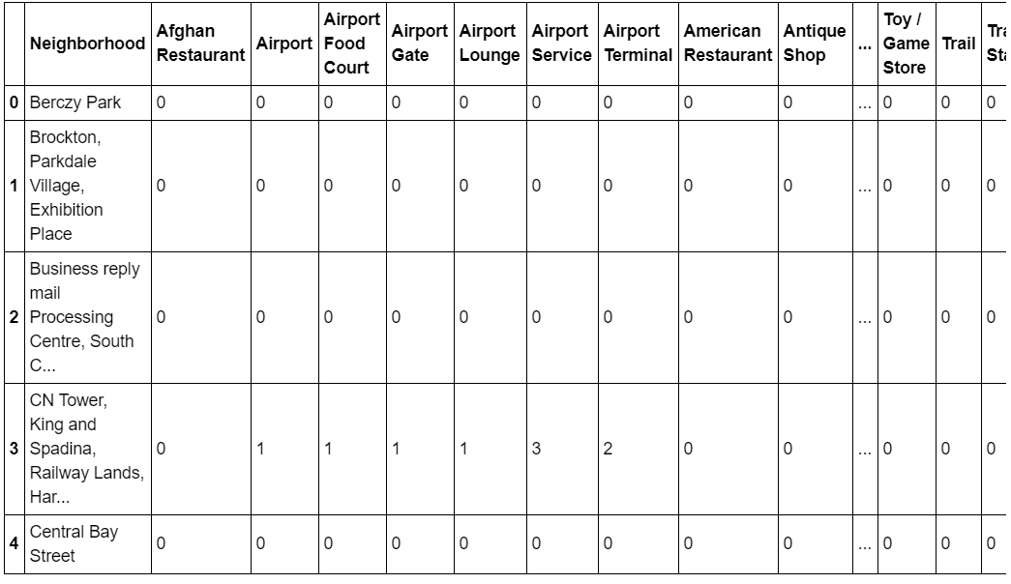
Create one-hot coding for each category

Slide 11

5. Build Model for Prediction
We will use number of venues in each neighborhoods except Indian restaurants as Input
and number of Indian restaurants as Output.
Use SVR(rbf kernel) as learning algorithm.
STEP 1 – Optimize the hyperparameter using GridSearchCV on parameter ‘Gamma’ and ‘C’.5 fold
cross validation is used.
Best parameter is here

Slide 12
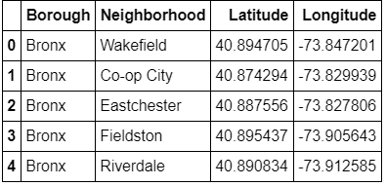
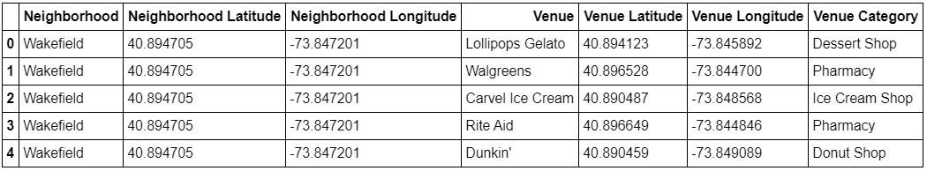
6. Get information of Target city
Neighborhoods information is get from https://cocl.us/new_york_dataset
Get venues information similar to Toronto

Slide 13
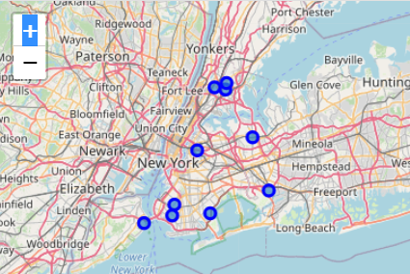
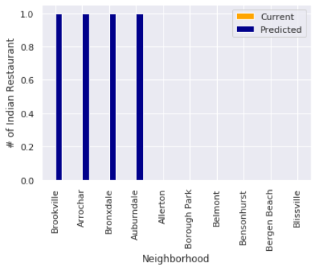
3. Result Predict using Trained model
Top 4 recommendations for
start your business
Top recommendations for start your
business in New York

Slide 14
4. Conclusion
We used FOURSQUARE API to get the venues information on given locations.
We build predictive model with SVR algorithm.
We get Top recommendations of location to invest “Indian restaurant” in New York.
These things can make model better:-
1. This model is build on the assumption that the target city will have a trend to grow to
much bigger city.
2. The training dataset very small, if we get more data from more big cities we can make
the model better.
3. Foursquare app can only give 100 venues exploration on free version, it is better to
conclude all of the venues to avoid bias coming from the sampling.

Slide 15
5. Acknowledgment
In this project, I acknowledge that the Data Science course provided by IBM
powered by Coursera.

